Slide 1
Database Systems
Relational Operators: Building Blocks
Of Relational Query Answering
何明昕 HE Mingxin, Max
Send your email to c.max@yeah.net with
a subject like: DBS345-Andy: On What …
Download from c.program@yeah.net
/文件中心/网盘/DatabaseSystems2021

Slide 2
Relational Operators: Building Blocks of Relational Query Answering
Finally, how rather than what

Slide 3
DBMS Architecture
Web Forms
Application Front Ends
SQL Interface
SQL Commands
Query Evaluation Engine
Plan Executor
Parser
Operator Evaluator
Optimizer
Transaction Manager
File and Access Methods
Recovery Manager
DBMS
Concurrency Control
Buffer Manager
Storage Manager
Lock Manager
Disk Space Manager
Index Files
Database
System Catalog
Data Files

Slide 4
Query Execution
SQL Query
Query Parser
Parsed Query
Query Optimizer
Plan Generator
Plan Cost Estimator
Evaluation Plan
Query Plan Evaluator
Operator Evaluators

Slide 5
Logical vs Physical Operators
Logical operators
What they do
e.g., selection, project, join, union, grouping
Physical operators
How they do it
e.g., nested loop join, sort-merge join, hash join, index join

Slide 6
Example
𝜏_{buyer}
External Merge-sort
Quicksort for Internal, B=20
𝜋_{buyer}
SELECT DISTINCT P.buyer
FROM Purchase P,
Person Q
WHERE P.buyer=Q.name
AND Q.city=‘Madison’
ORDER BY P.buyer
Hash-based Projection
⨝_{buyer=name}
Nested Loop Join
𝜎_{city = ‘Madison’}
Purchase
Table Scan
Index Scan
Assume that Person has a hash index on city
Person
Purchase
Person

Slide 7
Relational Operations
A query plan
Logical tree
Implementation choice at every node
Scheduling of operations
Will see implementations for the following relational operations
Select
Project
Join
Aggregation
Set operators

Slide 8
Selection
Example: 𝜎_{city=‘Madison’}(Purchase)
Access path: a specific way of retrieving tuples from a relation
File scan access path
Scan the entire file of R, match selection predicate for each tuple
Cost = O(N) where N is the number of R’s pages
Indexed access path
Use an index matching the selection predicate (e.g. city=‘Madison’)
Cost varies depending on the index

Slide 9
Selection: Example
User(UID, Name, Age)
SELECT UID, Name
FROM User
WHERE Age BETWEEN 20 AND 30
Access path | S = 1 | S = 10
Unsorted file scan | 10000 | 10000
1M records
Each page holds
100 records, or
500 (key, rid) pairs
S% of records satisfy the selection criteria
Sorted file scan | ~14+100 | ~14+1000
Unclustered B+tree on Age | 3+10000 | 3+100000
Clustered B+tree on Age | 3+100 | 3+1000

Slide 10
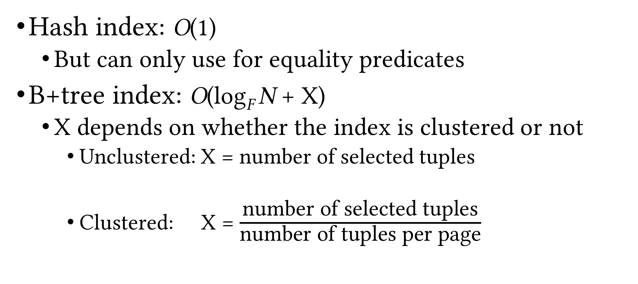
Index Scan Cost
Hash index: O(1)
But can only use for equality predicates
B+tree index: O(log_{F} N + X)
X depends on whether the index is clustered or not
Unclustered: X = number of selected tuples
Clustered: X = $\frac{\text{number} \text{of} \text{selected} \text{tuples}}{\text{number} \text{of} \text{tuples} \text{per} \text{page}}$

Slide 11
Matching Index
An index matches a predicate when it can be used to evaluate the predicate in a query
Example
User(UID, Name, Age)
Access path | Age = 22 | Age >= 24
Hash index on Age | ✓ | ⨯
Clustered B+tree on Age | ✓ | ✓
⨯
Unclustered B+tree on Age
⨯
✓
✓
First sort rids based on pid

Slide 12
Matching Index (Cont.)
Example
User(UID, Name, Age, ParentID)
Access path | Age = 22 | Age >= 24
Hash index on (Age, Name) | ⨯ | ⨯
Clustered B+tree on Age | ✓ | ✓
Prefix-match property of B+tree indexes
Clustered B+tree on (Age, Name) | ✓ | ✓
Clustered B+tree on (Age, Name, ParentID) | ✓ | ✓
Clustered B+tree on (Name, Age) | ⨯ | ⨯

Slide 13
General Selection Condition
A combination of predicates
e.g. R.a>10, R.c=23, R.a>10 ∧ R.c=23, R.a>10 ∨ R.c=23
Convert to conjunctive normal form (CNF)
General form: p₁ ∧ p₂ … ∧ p_{n} where each p_{i} is called a conjunct
Example: (R.a>10 ∧ R.c=23) ∨ R.b<=12
Convert to (R.a>10 ∨ R.b<=12) ∧ (R.c=23 ∨ R.b<=12)
An index can be used to evaluate a selection operation only if it matches some predicate in the selection condition

Slide 14
Conjunction of Simple Predicates
Selection condition p₁ ∧ p₂ … ∧ p_{n} where each p_{i} is a simple predicate (i.e. of the form “att op val”)
e.g. a=7 ∧ b<5 ∧ c=4
When can we use an index to evaluate a selection?
Hash index on search key K
If all p_{i}s are equality predicates (e.g. Age=23) and the set of attributes in K is a subset of attributes appearing in p₁, p₂, …,p_{n}
B+tree index on search key K
If a prefix subset of K is a subset of attributes appearing in p₁, p₂, …,p_{n}
Primary conjunct: conjuncts in the selection conditions that an index matches

Slide 15
Conjunction of Simple Predicates (Cont.)
Example
R(a, b, c, d)
Index | a=10 ∧ b=24 | d=10 ∧ c<=19 ∧ a>24
HashInx(a, b) | ✓ | ⨯
HashInx(d) | ⨯ | ✓
B+tree(a, b) | ✓ | ✓
B+tree(b, a) | ✓ | ⨯
B+tree(b, c) | ✓ | ⨯
B+tree(b, c, d) | ✓ | ⨯
B+tree(c, d, a) | ⨯ | ✓

Slide 16
Disjunction of Simple Predicates
What if you have disjunctions?
Example
Relation R(a, b, c, d)
Selection condition: a=7 ∨ b<5 ∨ c=4
Hash index on a and B+tree index on (b, c)
Use both indexes to obtain partial results, then union them to generate the final result set
Hash index on a and B+tree index on b
Don’t use any indexes; scan the whole R
Can use indexes only when we have appropriate indexes for every simple predicate in the disjunction

Slide 17
General Selection Condition (Cont.)
More examples
Hash index on a and hash index on b
Selection condition: a=7 ∨ b>5
Need a scan
Hash index on a and B+tree on b
Selection condition: a=7 ∨ b>5
Scan or use both indexes (fetch rids and take the union)
Hash index on a and B+tree on b
Selection condition: (a=7 ∨ c>5) ∧ b>5
Scan or use B+tree
Hash index on (a, c) and B+tree on b
Selection condition: a=7 ∧ b>5 ∧ c=15
Use both indexes (fetch rids and take the intersection)

Slide 18
Matching Index (Cont.)
A selection condition can match more than one index
Example
Relation R(a, b, c, d)
Hash index on a and B+tree index on (b, c)
Selection condition: a=7 ∧ b=5 ∧ c=4
Which index should we use?
Use either index
Use both indexes, then intersect the rid sets, and then fetch the tuples

Slide 19
Matching Index (Cont.)
A predicate can match more than one index/access path
Example
Relation R(a, b, c)
Hash index on a and B+tree index on (a, c)
Selection condition: a=7 ∧ b=5
Which index should we use?
Decide based on selectivity of the access paths

Slide 20
Selectivity
Fraction of pages (data and index pages) that need to be retrieved if we use this access path to retrieve all the desired tuples
Want to choose the most selective path
Estimating the selectivity of an access path is a hard problem

Slide 21
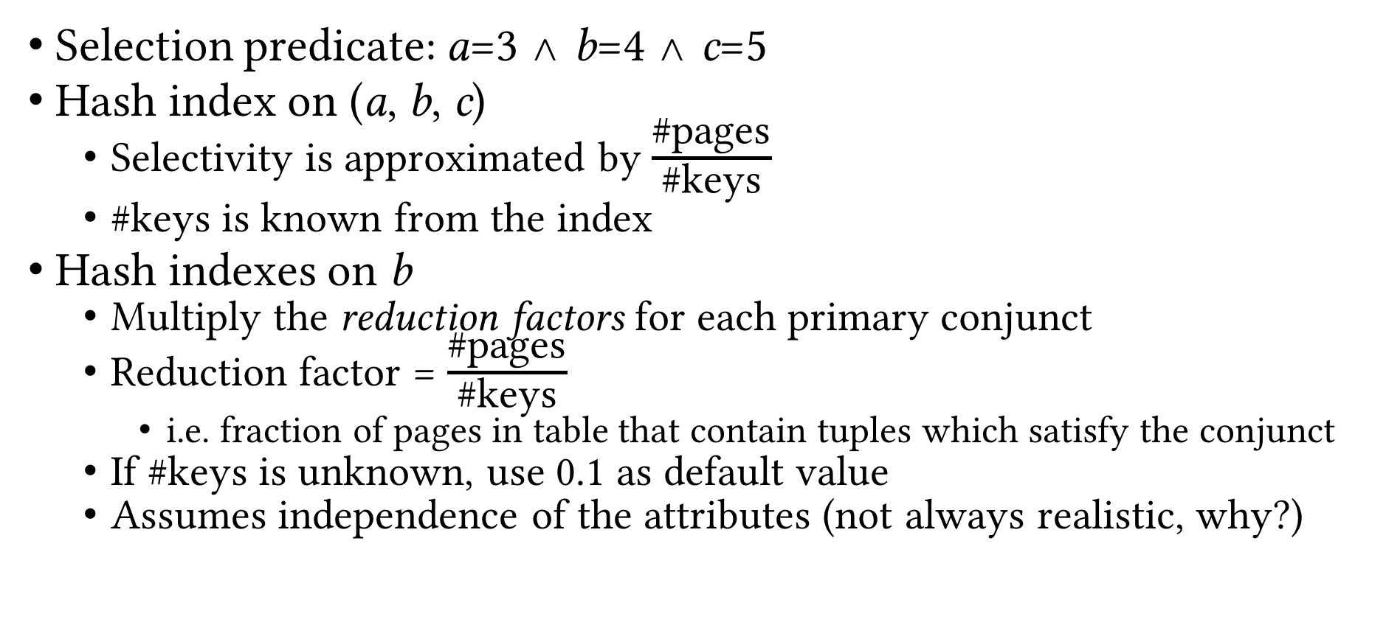
Estimating Selectivity: Example
Selection predicate: a=3 ∧ b=4 ∧ c=5
Hash index on (a, b, c)
Selectivity is approximated by $\frac{\text{\#}\text{pages}}{\text{\#}\text{keys}}$
#keys is known from the index
Hash indexes on b
Multiply the reduction factors for each primary conjunct
Reduction factor = $\frac{\text{\#}\text{pages}}{\text{\#}\text{keys}}$
i.e. fraction of pages in table that contain tuples which satisfy the conjunct
If #keys is unknown, use 0.1 as default value
Assumes independence of the attributes (not always realistic, why?)

Slide 22
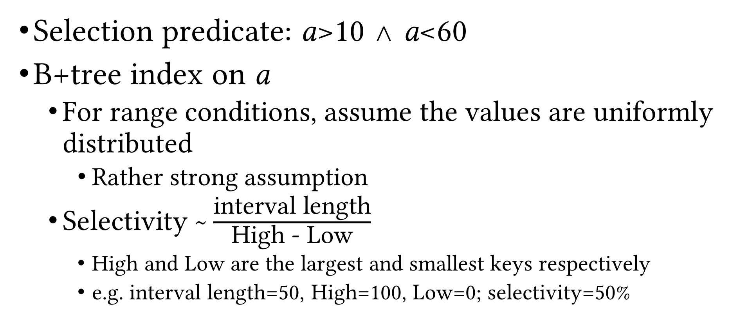
Estimating Selectivity: Example (Cont.)
Selection predicate: a>10 ∧ a<60
B+tree index on a
For range conditions, assume the values are uniformly distributed
Rather strong assumption
Selectivity ~ $\frac{\text{interval} \text{length}}{\text{High}\text{ − }\text{Low}}$
High and Low are the largest and smallest keys respectively
e.g. interval length=50, High=100, Low=0; selectivity=50%

Slide 23
Recap
Logical vs physical operations
Different ways of implementing each operation
Selection operation
Access paths
Scan
Utilize matching index
Decide among access paths
Use selectivity

Slide 24
Projection
Simple case: SELECT R.a, R.d
Scan the file and for each tuple output R.a, R.d
Hard case: SELECT DISTINCT R.a, R.d
Project out the attributes
Eliminate duplicate tuples (the difficult part!)
Two solutions
Sorting-based
Hashing-based

Slide 25
Sorting-based Deduplication
Sort R on (a, b)
During the first pass, eliminate everything but a and b from each tuple
Call the collection of resulting runs T
During the later passes, eliminate duplicates when encountered
Cost = N_{R}+N_{T}+EMrgCost(N_{T})
N_{R} = number of pages of relation R
N_{T} = number of pages storing the results of the first pass, i.e. containing a and b only
EMrgCost(N_{T}) = cost of merging (second and later passes of external merge-sort) N_{T} pages
What params would this depend on?
Notes:
N_{T}, B, b, double-buffering

Slide 26
Sorting-based Deduplication: Example
P₁₋₃
P₄₋₆
P₇₋₉
P₁₀₋₁₂
P₁₃₋₁₅
P₁₆₋₁₈
P₁₉
Input file
Pass 0
3,4
2,6
4,9
7,8
5,6
1,3
2
Pass 1
2,3
4,7
1,3
4,6
8,9
5,6
2
Pass 2
2,3
4,6
1,2
7,8
3,5
9
6
Pass 3
1,2
3,4
5,6
7,8
9

Slide 27
Hashing-based Deduplication
Create a hash table on R(a, b)
If the hash table fits entirely in memory, done!
Cost = N_{R}
Else, use a 2-phase algorithm
Partitioning: project out attributes and split the input into B-1 partitions using a hash function h₁
Deduplication: read each partition into memory and use an in-memory hash table (with a different hash function h₂) to remove duplicates

Slide 28
Hashing-based Deduplication (Cont.)
(Partitions of)
T
R
Hash table for partition i
Output
Partition buffers
1
2
h₂
INPUT
h₁
. . .
. . .
. . .
. . .
. . .
Output
buffer
B-1
Input buffer
for partition i
B buffer pages
B buffer pages
Partitioning
Deduplication

Slide 29
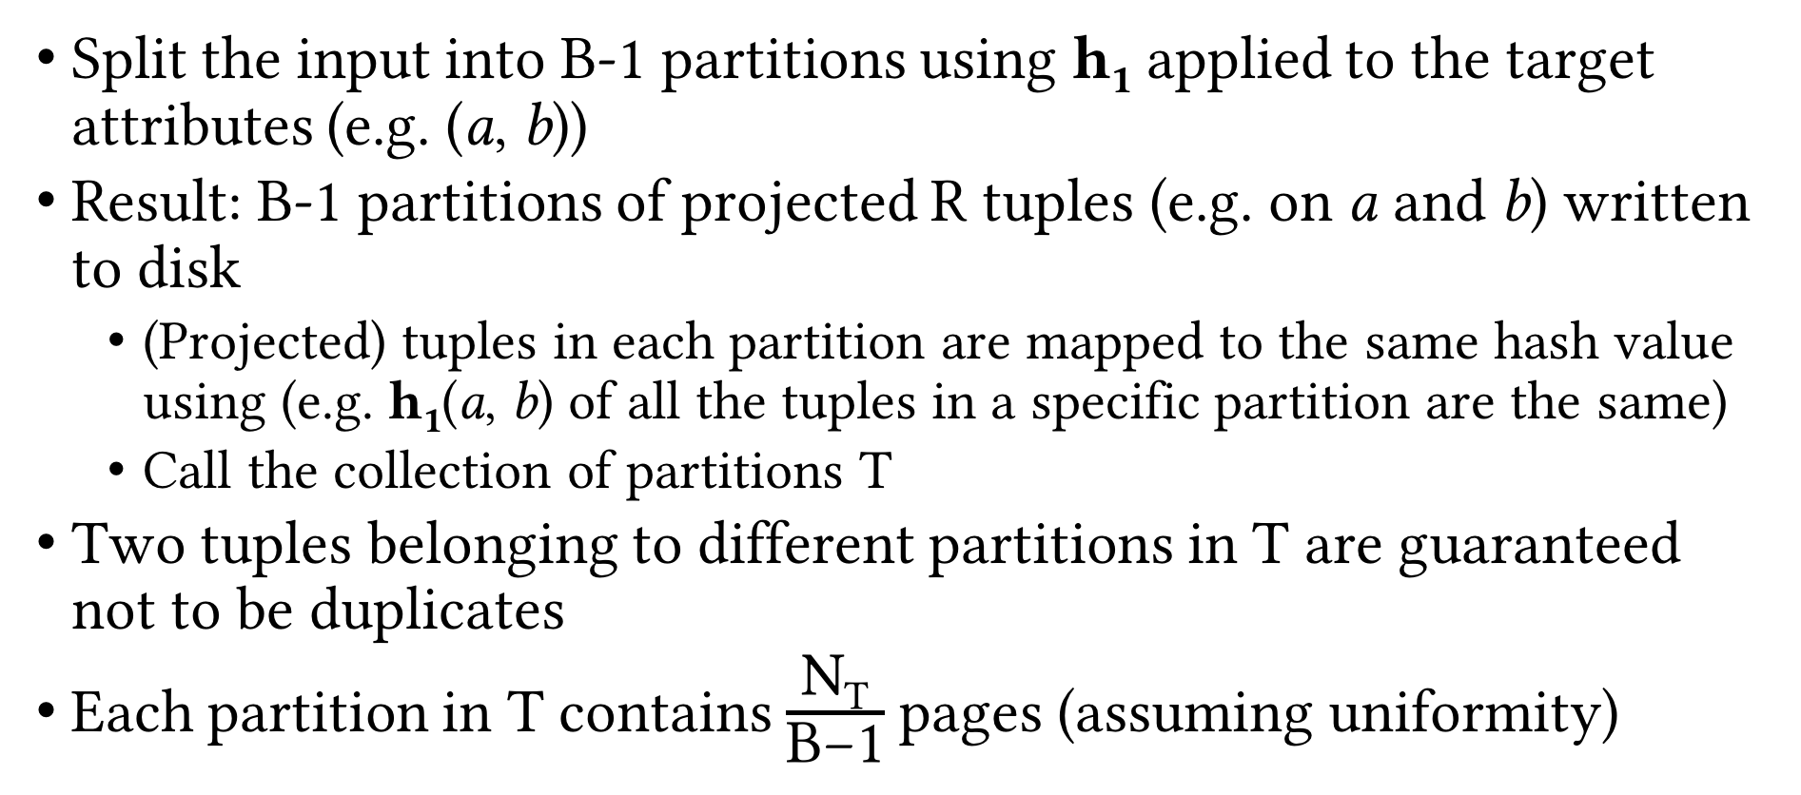
Partitioning Phase
Split the input into B-1 partitions using h₁ applied to the target attributes (e.g. (a, b))
Result: B-1 partitions of projected R tuples (e.g. on a and b) written to disk
(Projected) tuples in each partition are mapped to the same hash value using (e.g. h₁(a, b) of all the tuples in a specific partition are the same)
Call the collection of partitions T
Two tuples belonging to different partitions in T are guaranteed not to be duplicates
Each partition in T contains $\frac{\text{N}\text{T}}{\text{B}\text{−1}}$ pages (assuming uniformity)

Slide 30
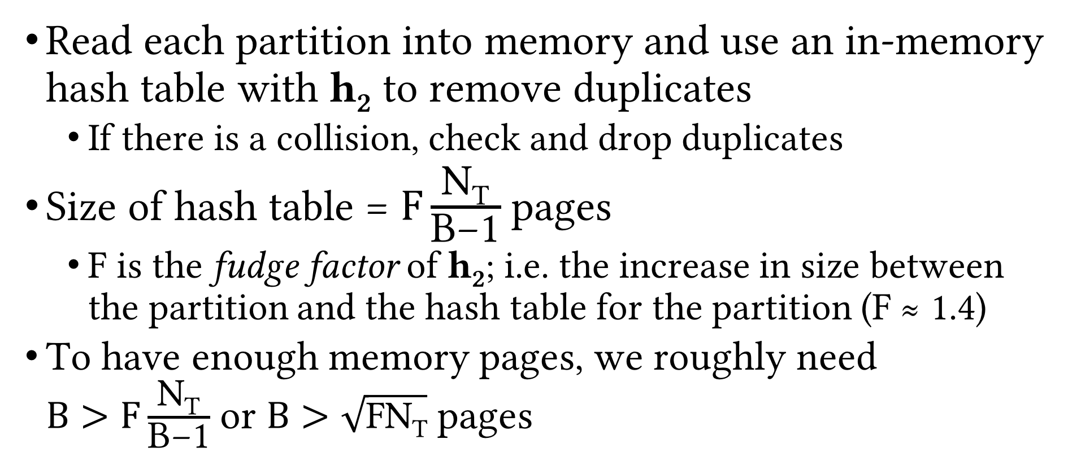
Deduplication Phase
Read each partition into memory and use an in-memory hash table with h₂ to remove duplicates
If there is a collision, check and drop duplicates
Size of hash table = $F\frac{\text{N}\text{T}}{\text{B}\text{−1}}$ pages
F is the fudge factor of h₂; i.e. the increase in size between the partition and the hash table for the partition (F ≈ 1.4)
To have enough memory pages, we roughly need $B>F\frac{\text{N}\text{T}}{\text{B}\text{−1}}$ or $B>\sqrt{\text{FN}\text{T}}$ pages

Slide 31
Sort- vs. Hashing-based Deduplication
Usually, I/O cost is the same = N_{R} + 2N_{T} (why?)
In practice, sorting-based is popular for projection
Gives sorted result (preferred)
Handles skewed data better

Slide 32
Using Indexes for Projection
Index with projection list as subset of index key (index-only scan)
Use only key values as the T for sorting/hashing
Tree-based index with projection list as prefix of index key
Leaf pages are already sorted on projection list
Just scan them in order, project out and deduplicate on-the-fly

Slide 33
Recap
Selection operation
Access paths
Scan vs utilize matching index
Use selectivity to decide among access paths
Projection operation
Sorting-based
Variations on external merge-sort
Hash-based
2-phase algorithm

Slide 34
Join Operation
We consider equi-join
Most common, important and well-studied join op
Example: Course ⨝_{Course.CID=Section.CID} Section
Various algorithms
Nested loop join
Block nested loop join
Index nested loop join
Block index nested loop join
Sort-merge join
Hash join

Slide 35
Nested Loop Join
Let R and S be the relations we want to join
Brain-dead solution: use nested for loops over the tuples of R and S
What’s wrong with this solution?
for each tuple t_{R} in R
for each tuple t_{S} in S
if tuple t_{R} and t_{S} match on the join attribute then
Concat t_{R} and t_{S} and output

Slide 36
Nested Loop Join: Example
SID | SName | Class | Major | DID | DeptName | Address
17 | Smith | 21 | MATH | MATH | Mathematics | ADD2
8 | Brown | 24 | CS | CS | Computer Sciences | ADD1
5 | Moreno | 21 | PHYS | PHYS | Physics | ADD3
⨝_{Major=DID}
R
S
SID | SName | Class | Major
17 | Smith | 21 | MATH
8 | Brown | 24 | CS
5 | Moreno | 21 | PHYS
DID | DeptName | Address
CS | Computer Sciences | ADD1
MATH | Mathematics | ADD2
PHYS | Physics | ADD3

Slide 37
Page Nested Loop Join (PNLJ)
Use nested for loops over the pages of R and S
R is called the outer relation and S is called the inner relation
Outer relation should be the smaller relation
i.e. N_{R} ≤ N_{S}
Q: How many buffer pages PNLJ need?
A: Three. Why?
for each page p_{R} in R
for each page p_{S} in S
Check every pair of tuples in p_{R} and p_{S},
and if they match, concat them and output
Q: What is the cost of PNLJ?
A: N_{R} + N_{R} * N_{S}

Slide 38
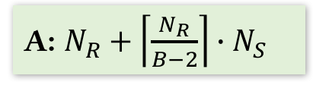
Block Nested Loop Join (BNLJ)
Better utilize memory buffers
In-memory all-pairs comparison could be quite slow (high CPU cost)
Solution: build a hash table on R pages in memory to reduce number of comparisons
Q: What is the cost of BNLJ?
for each block p_{R,1 , …,} p_{R,B-2} of B-2 pages of R
for each page p_{S} in S
Check every pair of tuples in p_{R,j} and p_{S},
and if they match, concat them and output
A: $N_{R}+\left\lceil \frac{N_{R}}{B−2}\right\rceil ∙N_{S}$
Q: What should be the key for this hash table?
A: The join attribute(s)
Q: How would the above cost change?
A: It doesn’t! Then why are we doing this?
Q: What if R fits in memory?

Slide 39
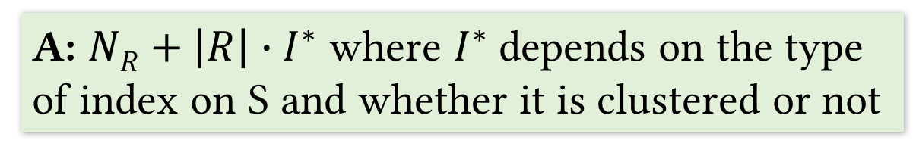
Index Nested Loop Join (INLJ)
Utilize existing indexes
Suppose S has an index on the join attribute(s)
for each page p_{R} of R
for each tuple t_{R} in p_{R}
Probe the index on S to find any tuples matching t_{R}
and if found, concat them and output
Q: What is the cost of INLJ?
A: $NR+\left|R\right|∙I^{∗}$ where $I^{∗}$depends on the type of index on S and whether it is clustered or not

Slide 40

Block Index Nested Loop Join (BINLJ)
Improve performance using available buffer pages
for each block p_{R,1 , …,} p_{R,B-2} of B-2 pages of R
Sort the tuples in the current block (in memory)
for each tuple t_{R} in the current sorted block
Probe the index on S to find any tuples matching t_{R}
and if found, concat them and output
Q: Why soring each block?
A: Reusing index and data pages in buffer
Q: What is the cost of BINLJ?
A: $NR+\left|R\right|∙I^{∗}$ where $I^{∗}$depends on the type of index on S and whether it is clustered or not

Slide 41
Recap
Selection
Access paths (scan, utilize matching index)
Decide among access paths (use selectivity)
Projection
Deduplication (sorting- vs hashing-based)
Join
NLJ, BNLJ, PNLJ, INLJ, BINLJ

Slide 42
PNLJ: Example
R ⨝_{Major=DID} S
S
Smith | MATH
Brown | CS
Moreno | ECON
Jefferies | CS
Suganthan | CS
Konda | CS
Xi | PHYS
Ramirez | CS
Javier | CS
Zhang | MATH
Lotfi | ECON
CS | Computer Sciences | Brown | CS
CS | Computer Sciences | Jefferies | CS
CS | Computer Sciences
MATH | Mathematics
PHYS | Physics
BIOL | Biology
Smith | MATH
Brown | CS
Moreno | ECON
Jefferies | CS
R
CS | Computer Sciences
MATH | Mathematics
PHYS | Physics
BIOL | Biology
ECON | Economics
INFOSCI | Information Sciences
CS | Computer Sciences | Brown | CS
CS | Computer Sciences | Jefferies | CS

Slide 43
PNLJ: Example (Cont.)
R ⨝_{Major=DID} S
S
Smith | MATH
Brown | CS
Moreno | ECON
Jefferies | CS
Suganthan | CS
Konda | CS
Xi | PHYS
Ramirez | CS
Javier | CS
Zhang | MATH
Lotfi | ECON
CS | Computer Sciences | Brown | CS
CS | Computer Sciences | Jefferies | CS
CS | Computer Sciences
MATH | Mathematics
PHYS | Physics
BIOL | Biology
Smith | MATH
Brown | CS
Moreno | ECON
Jefferies | CS
R
CS | Computer Sciences
MATH | Mathematics
PHYS | Physics
BIOL | Biology
ECON | Economics
INFOSCI | Information Sciences
MATH | Mathematics | Smith | MATH

Slide 44
PNLJ: Example (Cont.)
R ⨝_{Major=DID} S
S
Smith | MATH
Brown | CS
Moreno | ECON
Jefferies | CS
Suganthan | CS
Konda | CS
Xi | PHYS
Ramirez | CS
Javier | CS
Zhang | MATH
Lotfi | ECON
CS | Computer Sciences | Brown | CS
CS | Computer Sciences | Jefferies | CS
CS | Computer Sciences
MATH | Mathematics
PHYS | Physics
BIOL | Biology
Suganthan | CS
Konda | CS
Xi | PHYS
Ramirez | CS
R
CS | Computer Sciences
MATH | Mathematics
PHYS | Physics
BIOL | Biology
ECON | Economics
INFOSCI | Information Sciences
MATH | Mathematics | Smith | MATH

Slide 45
PNLJ: Example (Cont.)
R ⨝_{Major=DID} S
S
Smith | MATH
Brown | CS
Moreno | ECON
Jefferies | CS
Suganthan | CS
Konda | CS
Xi | PHYS
Ramirez | CS
Javier | CS
Zhang | MATH
Lotfi | ECON
CS | Computer Sciences | Brown | CS
CS | Computer Sciences | Jefferies | CS
CS | Computer Sciences
MATH | Mathematics
PHYS | Physics
BIOL | Biology
MATH | Mathematics | Smith | MATH
CS | Computer Sciences | Suganthan | CS
Suganthan | CS
Konda | CS
Xi | PHYS
Ramirez | CS
…
R
CS | Computer Sciences
MATH | Mathematics
PHYS | Physics
BIOL | Biology
ECON | Economics
INFOSCI | Information Sciences
MATH | Mathematics | Smith | MATH
CS | Computer Sciences | Suganthan | CS

Slide 46
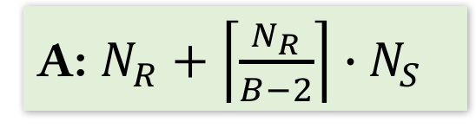
Block Nested Loop Join (BNLJ)
Better utilize memory buffers
for each block p_{R,1 , …,} p_{R,B-2} of B-2 pages of R
for each page p_{S} in S
Check every pair of tuples in p_{R,j} and p_{S},
and if they match, concat them and output
Q: What is the cost of BNLJ?
A: $N_{R}+\left\lceil \frac{N_{R}}{B−2}\right\rceil ∙N_{S}$

Slide 47
BNLJ: Example
R ⨝_{Major=DID} S
B = 4
S
Smith | MATH
Brown | CS
Moreno | ECON
Jefferies | CS
Suganthan | CS
Konda | CS
Xi | PHYS
Ramirez | CS
Javier | CS
Zhang | MATH
Lotfi | ECON
CS | Computer Sciences
MATH | Mathematics
PHYS | Physics
BIOL | Biology
ECON | Economics
INFOSCI | Information Sciences
Smith | MATH
Brown | CS
Moreno | ECON
Jefferies | CS
R
CS | Computer Sciences
MATH | Mathematics
PHYS | Physics
BIOL | Biology
ECON | Economics
INFOSCI | Information Sciences

Slide 48
Index Nested Loop Join (INLJ)
Utilize existing indexes
Suppose S has an index on the join attribute(s)
for each page p_{R} of R
for each tuple t_{R} in p_{R}
Probe the index on S to find any tuples matching t_{R}
and if found, concat them and output
Q: What is the cost of INLJ?
A: $NR+\left|R\right|∙I^{∗}$ where $I^{∗}$depends on the type of index on S and whether it is clustered or not

Slide 49
Block Index Nested Loop Join (BINLJ)
Improve performance using available buffer pages
for each block p_{R,1 , …,} p_{R,B-2} of B-2 pages of R
Sort the tuples in the current block (in memory)
for each tuple t_{R} in the current sorted block
Probe the index on S to find any tuples matching t_{R}
and if found, concat them and output
Q: Why soring each block?
A: Reusing index and data pages in buffer
Q: What is the cost of BINLJ?
A: $NR+\left|R\right|∙I^{∗}$ where $I^{∗}$depends on the type of index on S and whether it is clustered or not

Slide 50
BINLJ: Example
R ⨝_{Major=DID} S
S
Smith | MATH
Brown | CS
Moreno | ECON
Jefferies | CS
Suganthan | CS
Konda | CS
Xi | PHYS
Ramirez | CS
Javier | CS
Zhang | MATH
Lotfi | ECON
CS | Computer Sciences
MATH | Mathematics
PHYS | Physics
BIOL | Biology
ECON | Economics
INFOSCI | Information Sciences
Brown | CS
Jefferies | CS
Suganthan | CS
Konda | CS
I_{S}
R
CS | Computer Sciences
MATH | Mathematics
PHYS | Physics
BIOL | Biology
ECON | Economics
INFOSCI | Information Sciences

Slide 51
Sort-merge Join (SMJ)
Join is like deduplication in that they both need to check equality
So we can sort R and S on join attribute(s) and then merge them to find matching tuples
Instead of dropping them as in deduplication, concat them and output
Sort R and S on join attribute(s)
Merge the sorted R and S on join attribute(s), check for matching (i.e. duplicate) tuples
If matching pair found, concat them and output
Q: What is the cost of SMJ?
A: EMS(R) + EMS(S) + N_{R} + N_{S} where EMS is the cost of external merge-sort

Slide 52
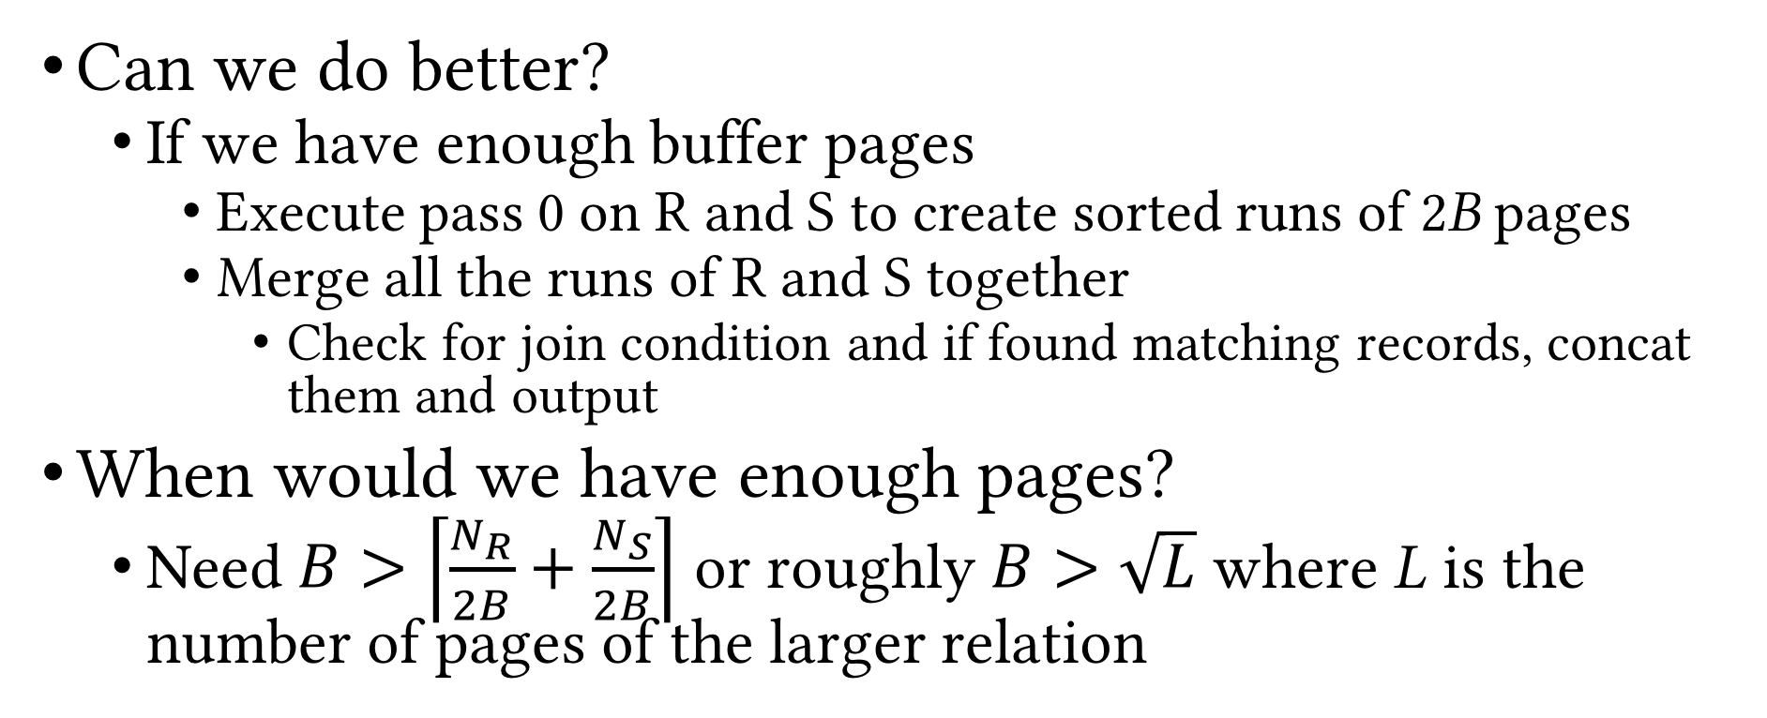
SMJ (Cont.)
Can we do better?
If we have enough buffer pages
Execute pass 0 on R and S to create sorted runs of 2B pages
Merge all the runs of R and S together
Check for join condition and if found matching records, concat them and output
When would we have enough pages?
Need $B>\left\lceil \frac{N_{R}}{2B}+\frac{N_{S}}{2B}\right\rceil$ or roughly $B>\sqrt{L}$ where L is the number of pages of the larger relation
Q: What is the cost of improved SMJ?
Q: What is the worst-case cost of improved SMJ?
A: 2(N_{R} + N_{S}) + N_{R} * N_{S} (why?)
A: 3(N_{R} + N_{S})

Slide 53
SMJ: Example
R
B = 8
R
EMS
Pass0
16 pages
15 pages
. . .
16 pages
5 pages
Output
S
S
EMS Pass0
11 pages
16 pages
. . .
12 pages
Merging

Slide 54
Hash Join (HJ)
Use hash-based deduplication to join tables
Partition R and S on join attribute(s) using hash function h₁
// Assume wlog that N_{R} ≤ N_{S}
for each partition R_{k} of R
Build an in-memory hash table on R_{k}
Probe the hash table with records in S_{k} and
check for matching tuples
If found, concat them and output

Slide 55
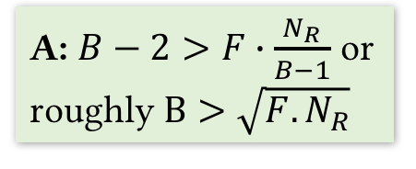
HJ (Cont.)
R
Partition buffers
Partitions of R
1
Q: What is the cost of HJ?
A: 3(N_{R} + N_{S})
INPUT
2
h₂
h₁
Output
. . .
. . .
. . .
Hash table for
R_{i}
B-1
h₂
S
Partitions of S
. . .
. . .
1
Output
buffer
2
Input buffer
for S_{i}
INPUT
h₁
. . .
. . .
. . .
Join (B buffer pages)
B-1
Q: What is memory requirement of HJ?
A: $B−2>F∙\frac{N_{R}}{B−1}$ or roughly $B>\sqrt{F.N_{R}}$
Partitioning (B buffer pages)

Slide 56
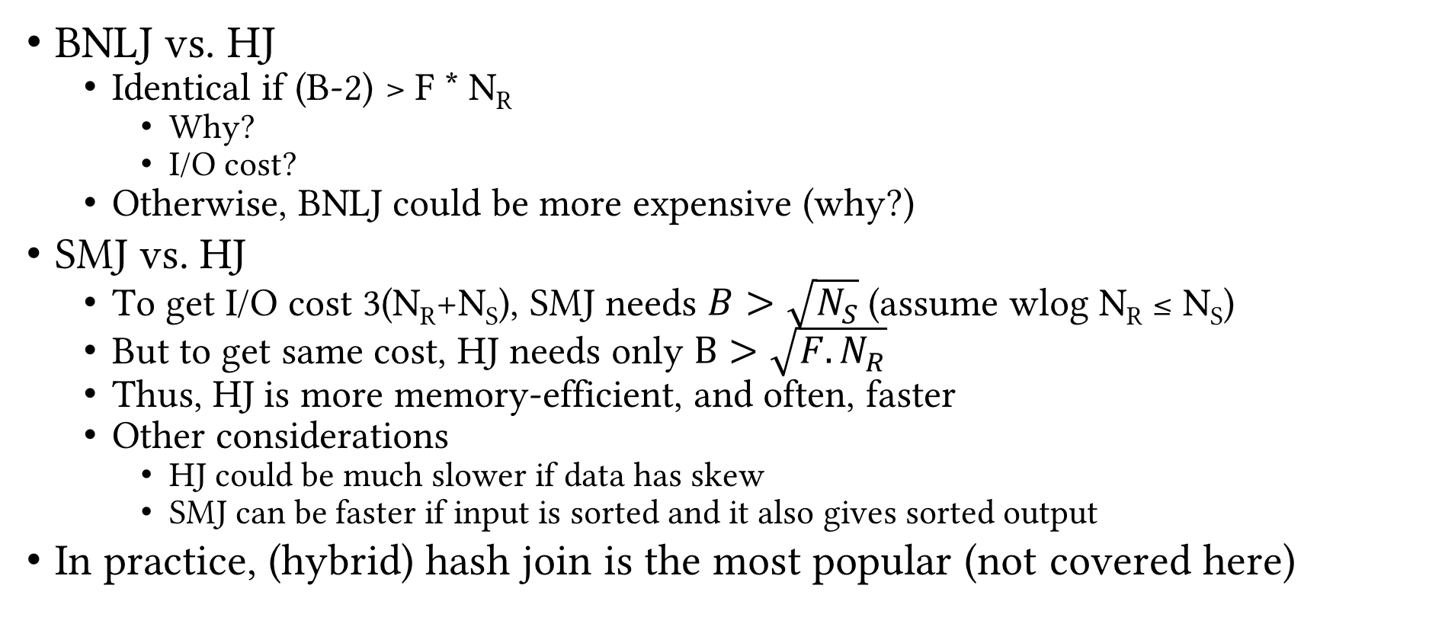
Comparison of Hash Algorithms
BNLJ vs. HJ
Identical if (B-2) > F * N_{R}
Why?
I/O cost?
Otherwise, BNLJ could be more expensive (why?)
SMJ vs. HJ
To get I/O cost 3(N_{R}+N_{S}), SMJ needs $B>\sqrt{N_{S}}$ (assume wlog N_{R} ≤ N_{S})
But to get same cost, HJ needs only $B>\sqrt{F.N_{R}}$
Thus, HJ is more memory-efficient, and often, faster
Other considerations
HJ could be much slower if data has skew
SMJ can be faster if input is sorted and it also gives sorted output
In practice, (hybrid) hash join is the most popular (not covered here)

Slide 57
General Join Conditions
Multiple equalities
e.g. R.a = S.b ∧ R.c = S.d
HJ works fine: hash R on (a, c) and S on (b, d)
SMJ works fine: sort S on (a, c) and S on (b, d)
INLJ: use (build, if needed) a matching index on S
Inequalities
e.g. R.a > S.b
HJ and SMJ not applicable
INLJ: use (build, if needed) a B+tree index on S
BNLJ might often be among the best choices
Inequality checks might lead to large outputs

Slide 58
System Support
 | (P/B/I/BI)NLJ | SMJ | HJ
PostgreSQL | ✓ | ✓ | ✓
Oracle Database | ✓ | ✓ | ✓
Microsoft SQL Server | ✓ | ✓ | ✓
MySQL | ✓ | ⨯ | ⨯
SQLite | ✓ | ⨯ | ⨯

Slide 59
Recap
Logical vs physical operations
Different ways of implementing each operation
Selection
Access paths (scan, utilize matching index)
Decide among access paths (use selectivity)
Projection
Deduplication (sorting- vs hashing-based)
Join
NLJ, BNLJ, PNLJ
INLJ, BINLJ
SMJ
HJ

Slide 60
Set Operations
Cross product (R × S)
Logically, an equi-join with no join condition
Use BNLJ
Intersection (R ∩ S)
Logically, an equi-join with join condition being a conjunction of all attributes
Same tradeoffs
Union (R ∪ S)
Similar to intersection, but need to deduplicate matching tuple pairs and output only once
Set difference (R − S)
Similar to duplicate elimination

Slide 61
Implementing Union and Set Difference
Sorting-based
Use SMJ (with all attributes as join attributes)
R ∪ S: deduplicate matching tuples during merge
R − S: exclude matching tuples during merge
Hashing-based
Use HJ (with all attributes as join attributes)
Build hash table on S_{i}
R ∪ S: probe hash table with R_{i}, if matching pair found, discard tuple, else insert R_{i} tuple into hash table
Hash table holds the output
R − S: probe hash table with R_{i}, if matching pair found, discard tuple, else output the R_{i} tuple

Slide 62
Aggregates
𝛾_{X,Agg(Y)}(R)
Easy case: X is empty
Simply aggregate values of Y
Not-so-easy case: X is not empty
Need to “collect” groups of tuples that match on X, then apply Agg(Y)
Three algorithms, using
Sorting
Hashing
Index

Slide 63
Evaluation of Aggregates: Easy Case
Keep running partial aggregate information and update incrementally, one tuple at a time
SUM and COUNT: partial sum or count
MAX and MIN: maximum or minimum value observed so far
AVG: partial sum AND count; at the end, calculate average as sum/count

Slide 64
Sorting-based Evaluation of Aggregates
Sort R on X
Read R into memory in sorted order
For every distinct value x_{i} of X
Compute the aggregate on the on the group of tuples with X=x_{i}
Output x_{i} and the aggregate value
Improvement: partial aggregation during the sort phase
Cost = sort(R)

Slide 65
Hashing-based Evaluation of Aggregates
Build hash table using X
Each bucket contains the X values and running partial aggregate information
For each tuple r in each page in R
If r(X) is present in hash table, update running info
Else, insert new X value into hash table and initialize running info
Hash table holds the final output in the end

Slide 66
Index-based Evaluation of Aggregates
Given B+tree index such that X ∪ Y is a subset of index key
Use leaf level of index instead of R for sorting-/hash-based aggregate evaluation
Given B+tree index such that X is a prefix subset of index key
Leaf level already sorted
Can fetch data records in order
If leaf pages contain the records, just one scan of leaf level is enough

Slide 67
Recap
Selection
Access paths (scan, utilize matching index)
Decide among access paths (use selectivity)
Projection
Deduplication (sorting- vs hashing-based)
Join
NLJ, BNLJ, PNLJ, INLJ, BINLJ, SMJ, HJ
Union and set difference
Sorting- and hashing-based
Aggregates
Sorting-, hashing- and index-based

Slide 68
Query Optimization
Next Up
Questions?

